Slide 1
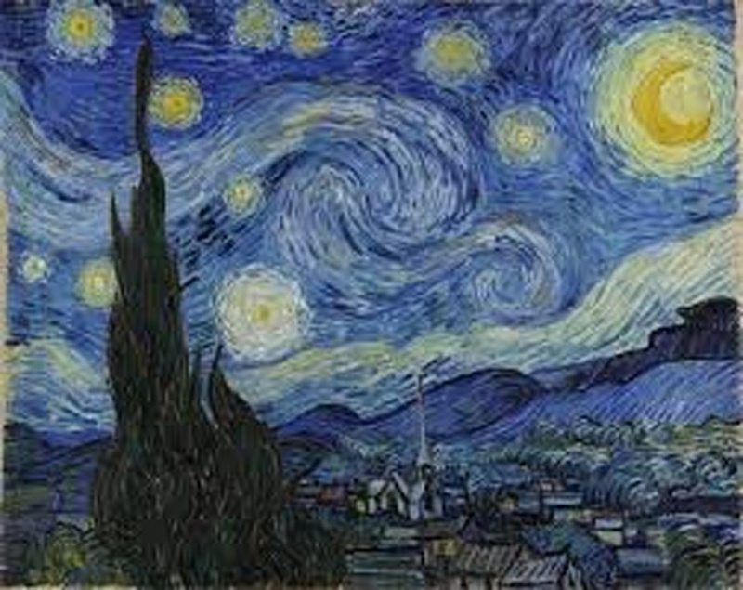

INTERNSHIP · PROGRESS REPORT
AI Driven Neural
Style Transfer
for Video.
TAHA GÜMÜŞ 20222303
EMİR BALTACI 20223899
WEEKS 1 – 2
Internship Group · May 2026
STYLE REFERENCE — Vincent van Gogh, The Starry Night (1889)

Slide 2




02
THE BRIEF
What we set out to build.
A pipeline that takes any video — a recorded file, a webcam feed — and re-paints every frame in the style of a chosen artwork. The output should look like a moving painting, not a flickering glitch.
01
02
Video, not images
Per-frame transform
Process full .mp4 streams end-to-end — input, transform, output.
Apply a style operation to every single frame individually.
03
04
Temporal smoothness
Painterly output
Reduce flicker between frames so motion feels coherent.
Preserve the style's palette, texture, and brush feel.
Neural Style Transfer · Progress Report
Internship Group · Weeks 1 – 2

Slide 3




03
THE PIPELINE
How a frame becomes a painting.
1
2
3
4
5
Input
Frame
Stylize
Smooth
Output
.mp4 / webcam
extract & resize
color + texture + painterly
optical flow blend
rendered video
cv2.VideoCapture
cap.read()
stylize()
TemporalSmoother
VideoWriter
Style image is loaded once at startup (starry_night.jpg) · every frame is matched against the same reference, so the output stays stylistically consistent across the whole clip.
Neural Style Transfer · Progress Report
Internship Group · Weeks 1 – 2

Slide 4
04
THE METHOD
Three operations, one painted frame.
Instead of a heavy VGG-based optimization loop, we built a fast classical pipeline. Each frame goes through three stacked passes — and the whole chain runs in real time.
01
02
03
Color Transfer
Texture Blend
Painterly Pass
Match the mean and standard deviation of each LAB channel from the style image into the content frame.
Split content and style into low/high frequency bands. Keep content structure, borrow style brushwork.
Edge-preserving smoothing flattens surfaces into paint blobs; adaptive thresholding adds contour lines.
cv2.cvtColor → LAB → match μ, σ
GaussianBlur + addWeighted
bilateralFilter + adaptiveThreshold
Neural Style Transfer · Progress Report
Internship Group · Weeks 1 – 2

Slide 5

05
THE FLICKER PROBLEM
Why we need temporal smoothing.
Each frame is stylized independently — which means tiny changes in pixel values produce wildly different paintings. Played back at 30 fps, that looks like strobing noise.
temporal_consistency.py
class TemporalSmoother: def apply(self, frame, styled): gray = cv2.cvtColor(frame, ...) flow = optical_flow(prev, gray) warped = warp(prev_styled, flow) result = (alpha * styled + (1 - alpha) * warped) return result.astype(np.uint8)
Ruder et al. (2016)
Artistic style transfer for videos · arXiv:1604.08610
OUR FIX
Compute optical flow between consecutive frames, warp the previous stylized output forward, and blend α·new + (1−α)·warped_prev.
Neural Style Transfer · Progress Report
Internship Group · Weeks 1 – 2

Slide 6
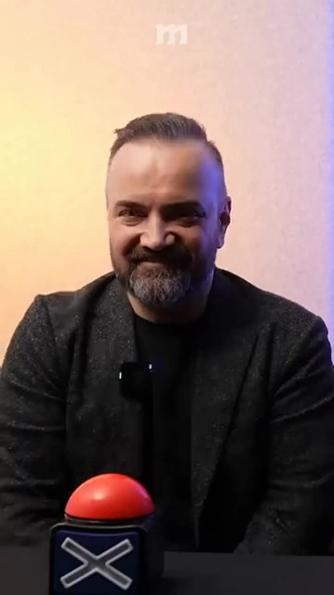
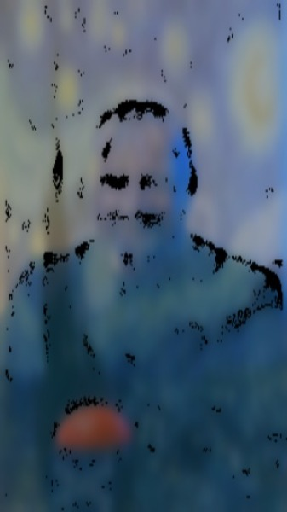
06
THE RESULT
Before & after.
DEMO SOURCE
ORIGINAL
STYLIZED
firstvideo.mp4
15s
454
30
duration
frames
fps
Each frame of the source video passes through the full pipeline. The Starry Night palette and brushwork transfer onto every frame; temporal smoothing keeps motion coherent across playback.
Neural Style Transfer · Progress Report
Internship Group · Weeks 1 – 2

Slide 7


07
WHERE WE ARE
Two weeks in.
Completed
OVERALL
70%
Video I/O pipeline (read → process → write)
Per-frame stylization (3-pass classical method)
Optical-flow temporal smoother integrated
Hotkeys: save, toggle temporal, tune style weight
of the planned pipeline scope completed.
In progress
Visual quality refinement (painterly artifacts)
Weeks 1 – 2 · May 2026
Speed optimization for HD video
Testing on varied content (motion, lighting)
Neural Style Transfer · Progress Report
Internship Group · Weeks 1 – 2

Slide 8


08
OPEN PROBLEMS
What still needs solving.
Honest list — these are the four issues we'd flag in code review right now.
Painterly artifacts
QUALITY
Detail loss
QUALITY
Adaptive thresholding in the painterly pass produces hard black contours that fragment the output. Looks more like a comic panel than an oil painting on busy frames.
Bilateral filtering flattens fine texture — faces lose subtle features. Need to tune sigmaColor/sigmaSpace or skip the painterly pass on close-ups.
Fast-motion flicker
MOTION
HD throughput
SPEED
Farneback optical flow degrades on rapid movement and large displacements. Flicker still visible in clips with quick camera pans.
Pipeline downsamples to 256×256 internally for speed. Full HD frames need batched processing or GPU acceleration to hit real-time.
Neural Style Transfer · Progress Report
Internship Group · Weeks 1 – 2

Slide 9
09
WHAT'S NEXT
The path forward.
Three weeks. Three milestones.
← shipped (weeks 1–2)
ahead →
Quality refinement
Better temporal stability
Speed & deployment
Soften painterly contours
Tune bilateral filter params
Test alternative style images
Try DIS / RAFT optical flow
Tune α per motion magnitude
Long-term temporal loss
Batched GPU pipeline
Real-time webcam at 720p
Optional VGG-based path
Neural Style Transfer · Progress Report
Internship Group · Weeks 1 – 2

